Slide 1
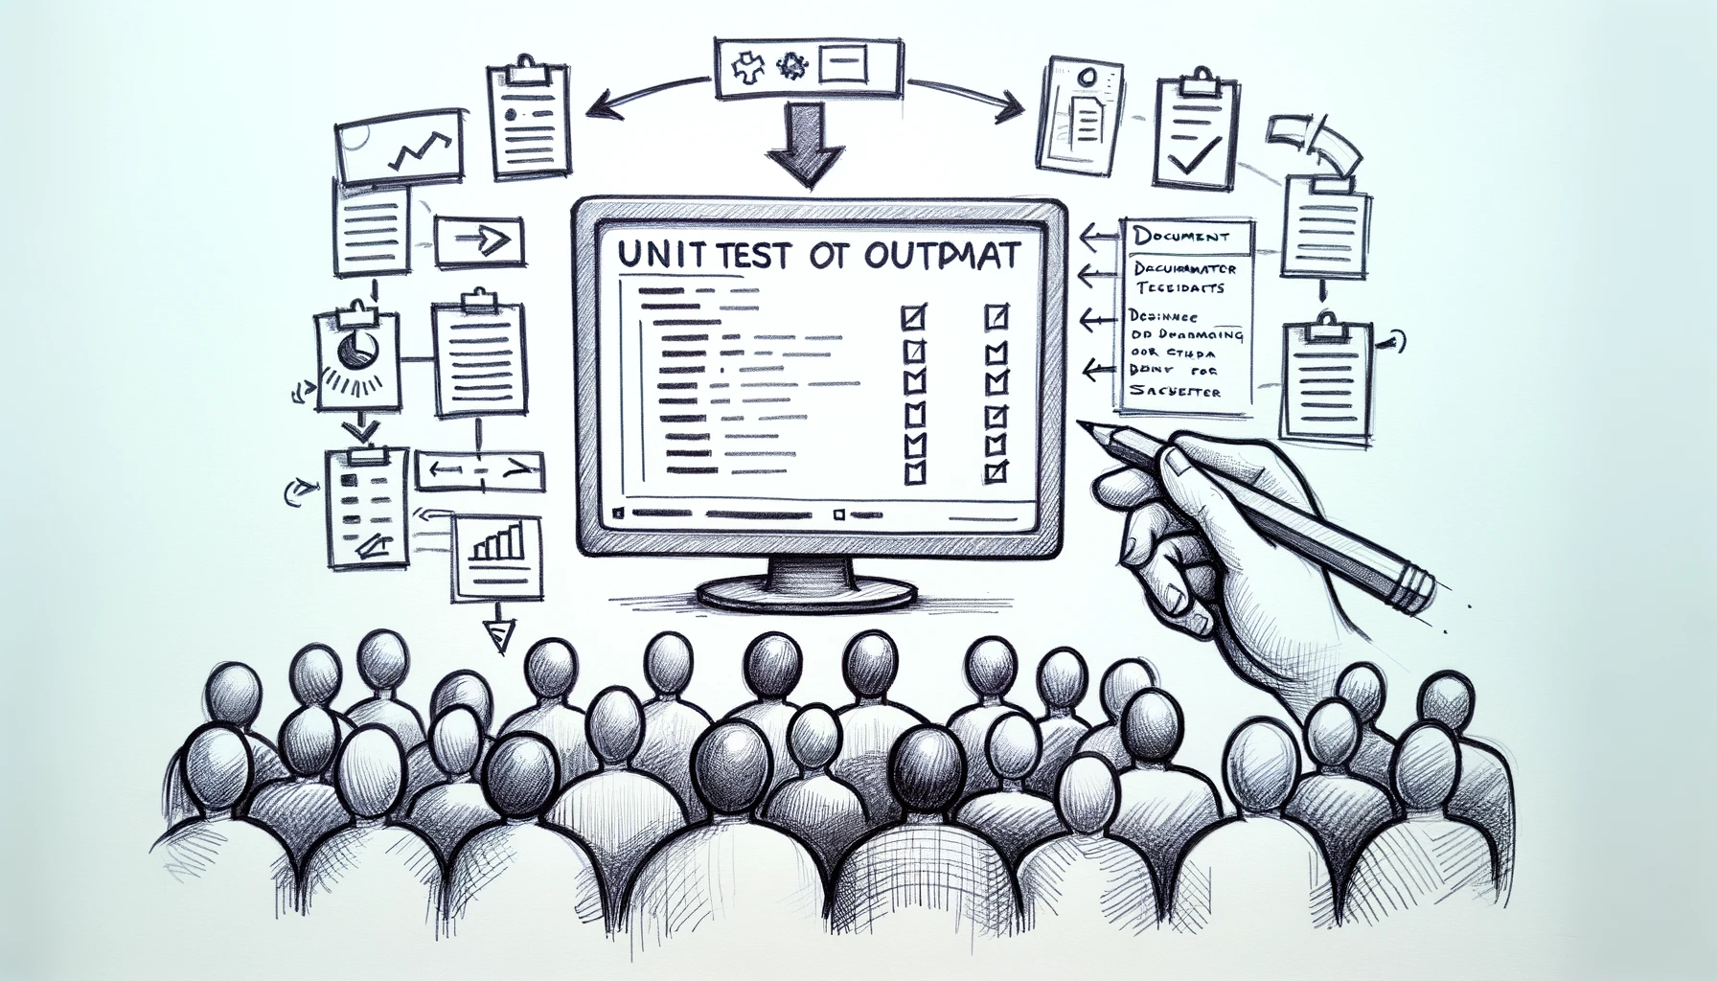
Better Testing with Approvals
Better Testing with ApprovalTests
Llewellyn Falco
Lada Kesseler
Llewellyn Falco
Lada Kesseler

Slide 2
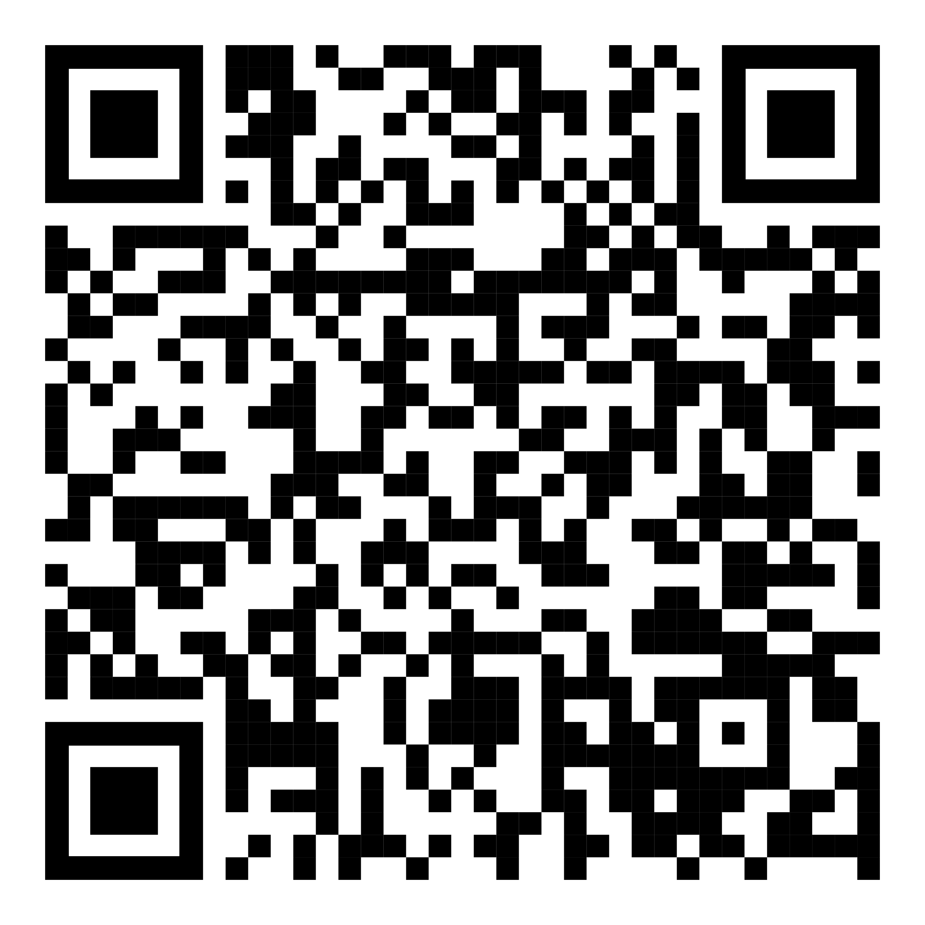
Resources
Notes:
https://github.com/isidore/Talks/blob/master/BetterTestingWithApprovals.md

Slide 3
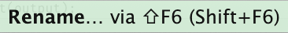
Housekeeping:
Presentation assistant

Slide 4
Housekeeping:
Presentation assistant

Slide 5
Housekeeping:
Presentation assistant

Slide 6
Housekeeping:
Presentation assistant

Slide 7
Housekeeping:
Presentation assistant

Slide 8

..
..
Clear
Expressive
Simple
Notes:
Re-telling
just under test
iterative experience
stakeholder documentation
Lada set the stage
couple months
working together
chatbot application
converted manual tests
fast tests
hexagonal architecture
without DynamoDb or Kafka
excited
show
Good unit tests, but failed attempt at anything above – because integration tests are fraglie
Tried something new, refactored the system to hexagonal
Automated tests that weren’t depending on infrastructure

Slide 9

In the beginning...

Slide 10
code

Slide 11
Problem:
What the test does is confusing

Slide 12
New Concept #1:
Testing Circle

Slide 13
// Create side (0,0) – (3,4)
// Verify length
Whiteboard
English
Testing Circle
Result
Code
Side (0,0) – (3,4) length = 5
Side s = new Side(0,0,3,4);
Approvals.Verify(s + “ length = “ +s.Length);

Slide 14
// Create side (0,0) – (3,4)
// Verify length
Whiteboard
English
Testing Circle
Result
Code
Side (0,0) – (3,4) length = 5
Side s = new Side(0,0,3,4);
Approvals.Verify(s + “ length = “ +s.Length);

Slide 15
// Create side (0,0) – (3,4)
// Verify length
Whiteboard
English
Testing Circle
Result
Code
Side (0,0) – (3,4) length = 5
Side s = new Side(0,0,3,4);
Approvals.Verify(s + “ length = “ +s.Length);

Slide 16
// Create side (0,0) – (3,4)
// Verify length
Whiteboard
English
Testing Circle
Result
Code
Side (0,0) – (3,4) length = 5
Side s = new Side(0,0,3,4);
Approvals.Verify(s + “ length = “ +s.Length);

Slide 17
// Create side (0,0) – (3,4)
// Verify length
Whiteboard
English
Testing Circle
Result
Code
Side (0,0) – (3,4) length = 5
Side s = new Side(0,0,3,4);
Approvals.Verify(s + “ length = “ +s.Length);

Slide 18
Chat
[Customer]
hi
[Bot]
Hi there! I'm your virtual assistant.
What would you like to do today?
Notes:
we put the focus on what it is that we're testing, and not the setup of the test

Slide 19
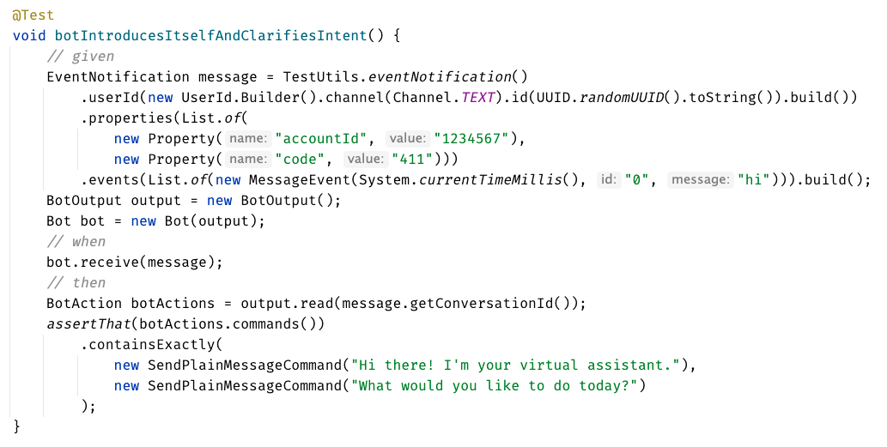

Slide 20
Chat
[Customer]
hi
[Bot]
Hi there! I'm your virtual assistant.
What would you like to do today?
Whiteboard
English
Testing Circle
Result
Code

Slide 21
Chat
[Customer]
hi
[Bot]
Hi there! I'm your virtual assistant.
What would you like to do today?
// customer says ‘hi’
// verify conversation
Whiteboard
English
Testing Circle
Result
Code

Slide 22
Chat
[Customer]
hi
[Bot]
Hi there! I'm your virtual assistant.
What would you like to do today?
// customer says ‘hi’
// verify conversation
Whiteboard
English
Testing Circle
Result
Code
String userMessage = "hi"; verifyConversation(userMessage);

Slide 23
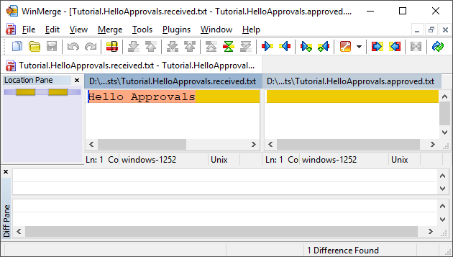
New Concept #2:
Approval Tests
Test + approved output

Slide 24
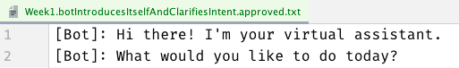
Chat
[Customer]
hi
[Bot]
Hi there! I'm your virtual assistant.
What would you like to do today?
// customer says ‘hi’
// verify conversation
Whiteboard
English
Testing Circle
Result
Code
String userMessage = "hi"; verifyConversation(userMessage);

Slide 25
Chat
[Customer]
hi
[Bot]
Hi there! I'm your virtual assistant.
What would you like to do today?
// customer says ‘hi’
// verify conversation
Whiteboard
English
Testing Circle
Result
Code
[Customer]: hi
String userMessage = "hi"; verifyConversation(userMessage);

Slide 26
Week 1
What happened
Notes:
Pay attention to the testing circle
Create convenience functions to hide unnecessary details

Slide 27
Complex
Tests
ApprovalTests
Testing Circle

Slide 29
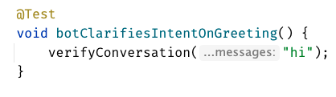
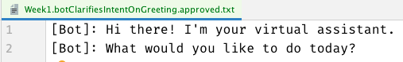

Slide 31
Week 1
learnings
Convenience Functions
ApprovalTests
Testing Circle
verifyConversation("hi");
Notes:
Pay attention to the testing circle
Create convenience functions to hide unnecessary details

Slide 32
...later next week...

Slide 33
code

Slide 34
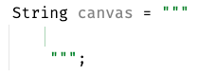
New Concept #3:
Story Board

Slide 35
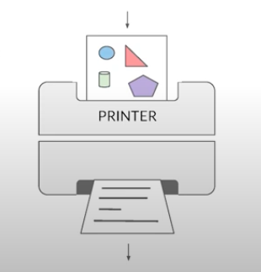
New Concept #4:
Printers
@EmillyBache

Slide 36
Problem:
Lack of clarity in the test code output

Slide 37
Chat
[Customer]
hi
[Bot]
Hi there! I'm your virtual assistant.
What would you like to do today?
[Customer]
pay bill
[Bot]
Are you a customer?
Yes, I'm a customer No, I'm not

Slide 38
[Customer]: hi [ Bot]: Hi there! I'm your virtual assistant. [ Bot]: What would you like to do today? [Customer]: pay bill [ Bot]: Let me try to help you. [ Bot]: { "content": { "type": "vertical", "elements": [ { "type": "text", "text": "Are you a customer?", "tooltip": "text tooltip" }, { "type": "horizontal", "elements": [ { "type": "button", "title": "Yes", "click": { "actions": [ { "type": "publishText", "text": "Yes, I'm a customer" } ] } }, { "type": "button", "title": "No", "click": { "actions": [ { "type": "publishText", "text": "No, I'm not" } ] } } ] } ] } }
Chat
[Customer]
hi
[Bot]
Hi there! I'm your virtual assistant.
What would you like to do today?
[Customer]
pay bill
[Bot]
Are you a customer?
Yes, I'm a customer No, I'm not

Slide 39
Week 2
What happened
Notes:
Pay attention to the testing circle
Create convenience functions to hide unnecessary details

Slide 40

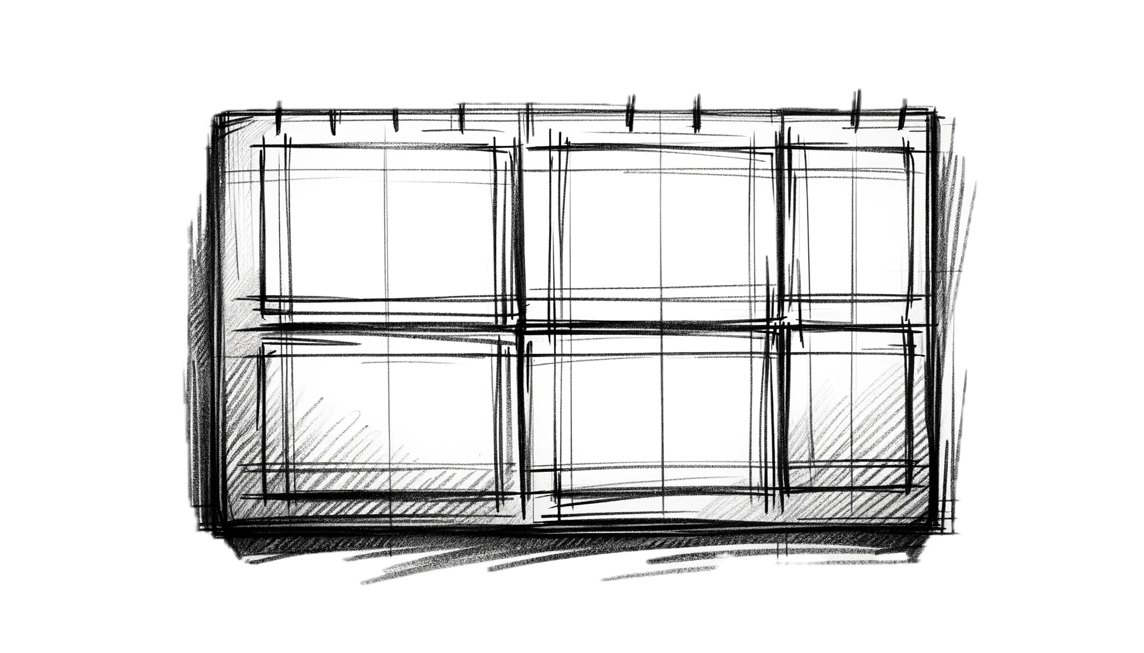
Complex
Tests
ApprovalTests
Testing Circle
Printers
+ Storyboard
JSON

Slide 41
Formatting
[Customer]: hi [Bot]: Hi there! I'm your virtual assistant. [Bot]: What would you like to do today?
[Customer]: hi [ Bot]: Hi there! I'm your virtual assistant. [ Bot]: What would you like to do today?

Slide 42
Formatting
[Customer]: hi [Bot]: Hi there! I'm your virtual assistant. [Bot]: What would you like to do today? [Customer]: hi [Bot]: Hmmm, tell me a little more so I can help you. What would you like to do today? [Customer]: hi [Bot]: Let me try to help you. [Bot]: Are you a customer? 1) Yes, I'm a customer 2) No, I'm not
[Customer]: hi
[ Bot]: Hi there! I'm your virtual assistant. [ Bot]: What would you like to do today? [Customer]: hi [ Bot]: Hmmm, tell me a little more so I can help you. [ ]: What would you like to do today? [Customer]: hi [ Bot]: Let me try to help you. [ Bot]: Are you a customer? [ ]: 1) Yes, I'm a customer [ ]: 2) No, I'm not

Slide 43
[Customer]: hi [ Bot]: Hi there! I'm your virtual assistant. [ Bot]: What would you like to do today? [Customer]: pay bill [ Bot]: Let me try to help you. [ Bot]: { "content": { "type": "vertical", "elements": [ { "type": "text", "text": "Are you a customer?", "tooltip": "text tooltip" }, { "type": "horizontal", "elements": [ { "type": "button", "title": "Yes", "click": { "actions": [ { "type": "publishText", "text": "Yes, I'm a customer" } ] } }, { "type": "button", "title": "No", "click": { "actions": [ { "type": "publishText", "text": "No, I'm not" } ] } } ] } ] } }
[Customer]: hi [ Bot]: Hi there! I'm your virtual assistant. [ Bot]: What would you like to do today? [Customer]: pay bill [ Bot]: Let me try to help you. [ Bot]: Are you a customer? [ ]: 1) Yes, I'm a customer [ ]: 2) No, I'm not

Slide 44

Week 2
learnings
Storytelling
Storyboard
Printers
Formatting
[Customer]: talk to an operator [ Bot]: Hi there! I'm your virtual assistant. [ Bot]: Let me try to help you. [ Bot]: Are you a customer? [ ]: 1) Yes, I'm a customer [ ]: 2) No, I'm not
Notes:
Pay attention to the testing circle
Create convenience functions to hide unnecessary details

Slide 45
...later next week...

Slide 46
code

Slide 47
Problem:
Too many .approved. files

Slide 48
New Concept #5:
Inline Approvals

Slide 49
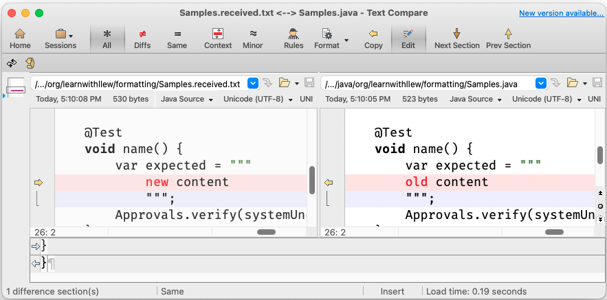
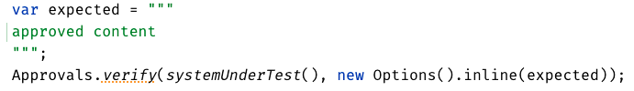
New Concept:
Inline Approvals
“Look mom, no files!”
Possible new source file
Original source file
Approved output
How to invoke
Pressing this modifies
your source code

Slide 50
Week 3
What happened
Notes:
Pay attention to the testing circle
Create convenience functions to hide unnecessary details

Slide 51
Complex
Tests
ApprovalTests
Testing Circle
Printers
+ Storyboard
JSON
Inline

Slide 52
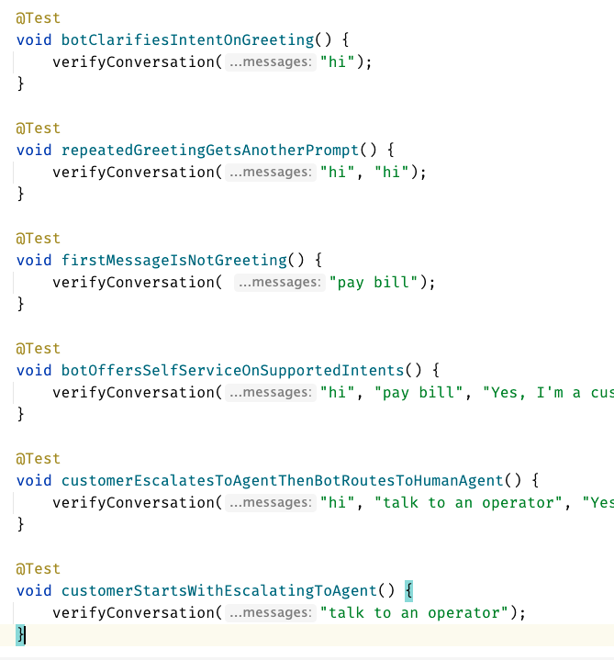
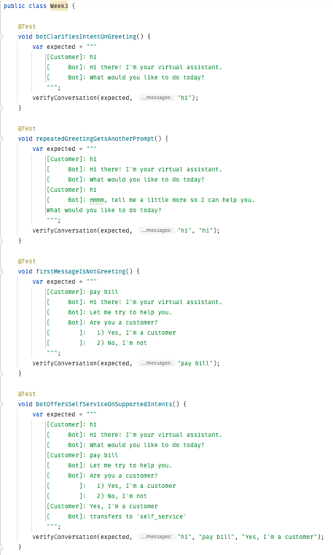
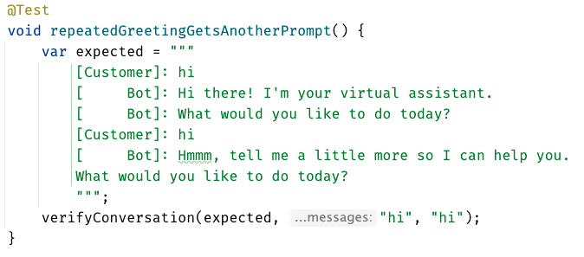
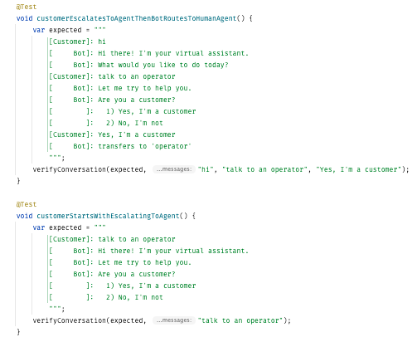
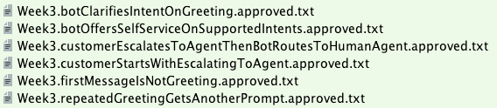

Slide 53
Week 3
learnings
Inline
Notes:
Pay attention to the testing circle
Create convenience functions to hide unnecessary details

Slide 54
...later next week...

Slide 55
code
Notes:
Hey Llewellyn, look what I did

Slide 56
Problem:
Can’t see the overall test strategy
hard to see if you’re missing cases...

Slide 57
New Concept #6:
verifyAll()

Slide 58
New Concept #7:
many of one

Slide 59
Week 4
What happened
Notes:
Pay attention to the testing circle
Create convenience functions to hide unnecessary details

Slide 60
Complex
Tests
ApprovalTests
Testing Circle
Printers
+ Storyboard
JSON
Verify all
Inline

Slide 61
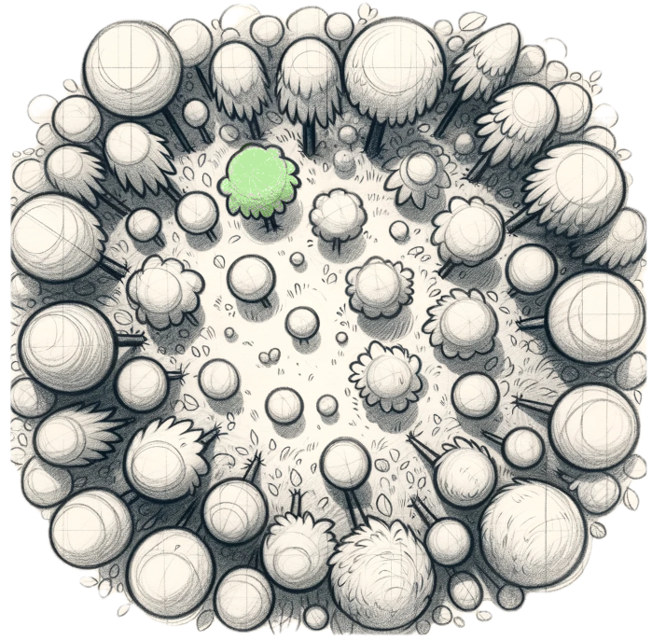
Week 4
learnings
Verify all
Printers
See the forest AND the trees
Notes:
Pay attention to the testing circle
Create convenience functions to hide unnecessary details

Slide 62
...later next week...

Slide 63
code
Notes:
1. convert to MultipleConversations (many of one)
2. add DSL (thenConversations)
3. move test1
4. move test2

Slide 64
Problem:
95% of tests are together
but 5% are alone...

Slide 65
New Concept #8:
Custom test scenario builders
creating Domain-Specific Language (DSLs)

Slide 66
Week 5
What happened
Notes:
Pay attention to the testing circle
Create convenience functions to hide unnecessary details

Slide 67
Complex
Tests
ApprovalTests
Testing Circle
Printers
+ Storyboard
JSON
Verify all
Inline
Test Scenario DSL

Slide 68
var conv1 = conversation("pay bill", "Yes, I'm a customer"); var conv2 = conversation("pay bill"); var conversations = new MultipleConversations(conv1, conv2);
conversation("pay bill", "No, I'm not") .thenConversation("pay bill")

Slide 69
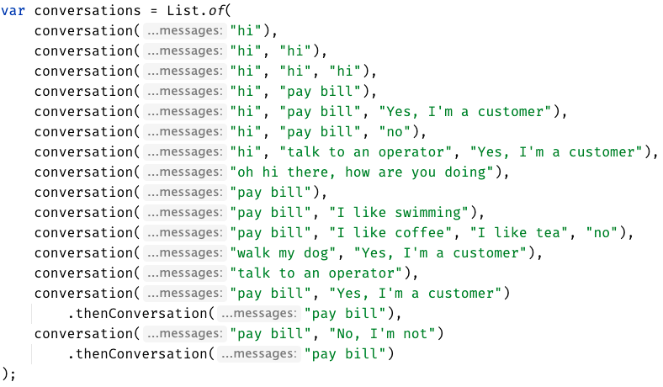

Slide 70
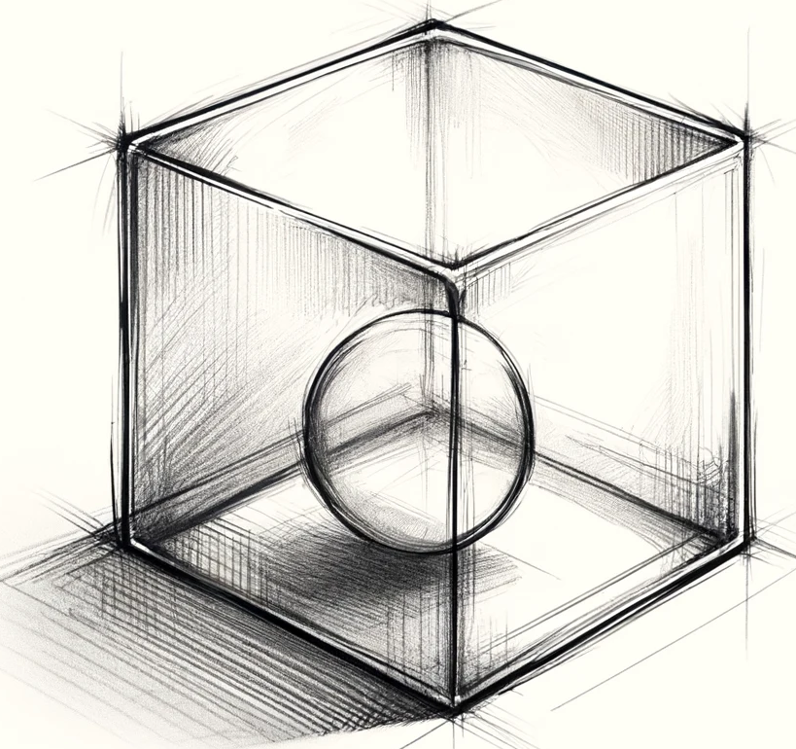
Week 5
learnings
See the forest AND the trees
(consistency)
Many of One
Test Scenario DSL
Notes:
Invest in APIs that make it easier to express test scenarios

Slide 71
...later next week...

Slide 72
code
Notes:
Hey Llewellyn, look what I did

Slide 73
Problem:
The tests are only for developers

Slide 74
New Concept #9:
Alternative .approved. files
new Options().forFile().withExtension(".md")
Notes:
stakeholders

Slide 75
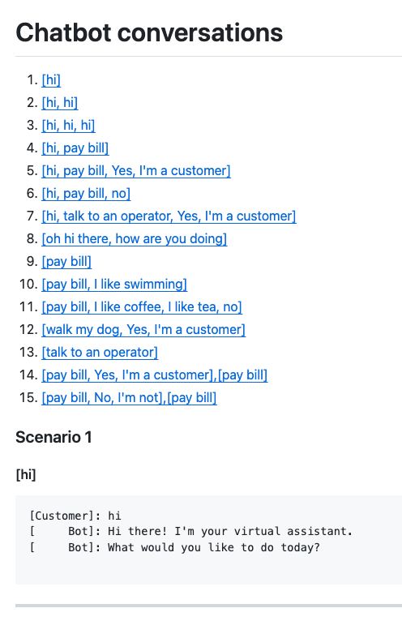
Complex
Tests
ApprovalTests
Testing Circle
Printers
+ Storyboard
markdown
Tests
work as Documentation
JSON
Verify all
Inline
Test Scenario DSL

Slide 76
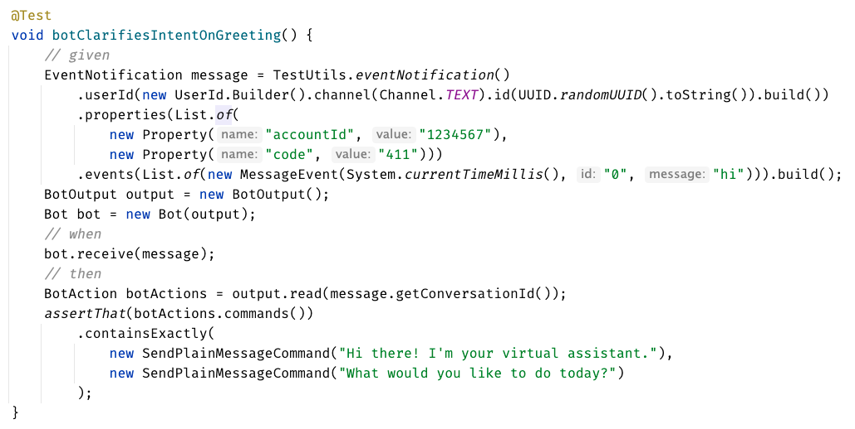
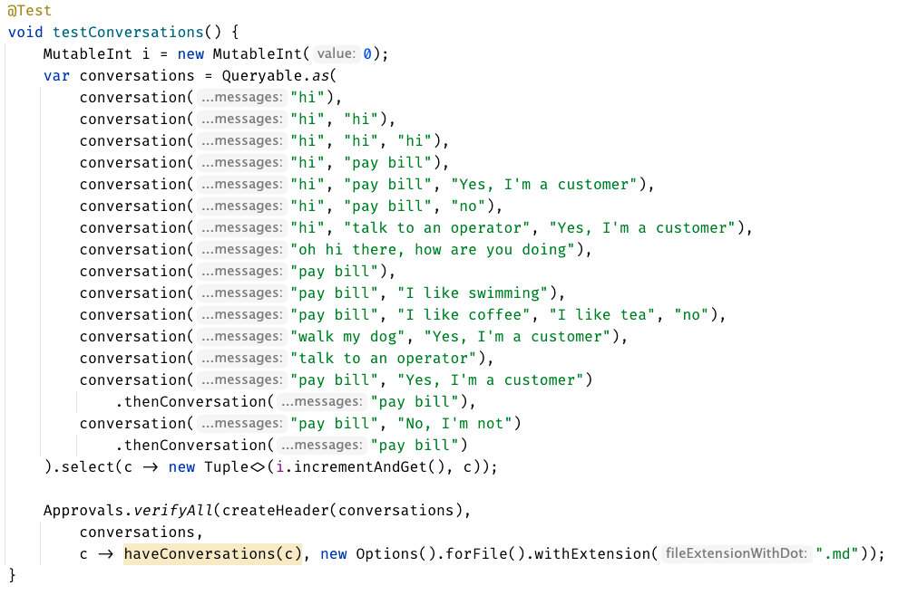

Slide 77
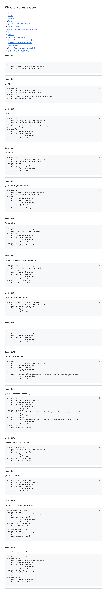

Slide 80
Concepts:
1. Testing Circle
2. Approval Tests
3. Story Board
4. Printers
5. Inline Approvals
6. verifyAll()
7. Many of one
8. Custom test scenario builders (DSL)
9. Alternative .approved. files (markdown)

Slide 81
learnings
Storyboard
ApprovalTests
Storytelling
Testing Circle
Printers
Inline
Convenience Functions
verifyConversation("hi");
Test Scenario DSL
See the forest AND the trees
Verify all
Markdown
Notes:
Pay attention to the testing circle
Create convenience functions to hide unnecessary details

Slide 82
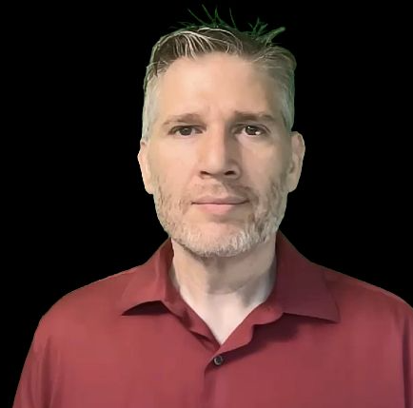

Resources
Thank you!
Llewellyn Falco
Lada Kesseler
Please connect on LinkedIn
Notes:
https://github.com/isidore/Talks/blob/master/BetterTestingWithApprovals.md

Slide 83
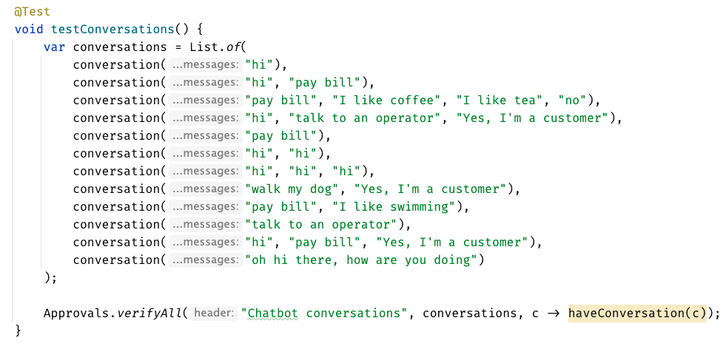

Slide 84
Chat
[Customer]
hi
[Bot]
Hi there! I'm your virtual assistant.
What would you like to do today?
Whiteboard
English
Testing Circle
Result
Code

Slide 85
Test.approved.txt
[Bot]: Hi there! I'm your virtual assistant. [Bot]: What would you like to do today?
Test.approved.txt
[Customer]: hi
[ Bot]: Hi there! I'm your virtual assistant. [ Bot]: What would you like to do today?

Slide 86
var expected = """ [Customer]: hi [ Bot]: Hi there! I'm your virtual assistant. [ Bot]: What would you like to do today? """; verifyConversations(expected, "hi");

Slide 87
var conversations = List.of( conversation("hi"), conversation("hi", "hi"), conversation("hi", "hi", "hi"), conversation("hi", "pay bill"), conversation("hi", "pay bill", "Yes, I'm a customer"), conversation("hi", "pay bill", "no"), conversation("hi", "talk to an operator", "Yes, I'm a customer"), conversation("oh hi there, how are you doing"), conversation("pay bill"), conversation("pay bill", "I like swimming"), conversation("pay bill", "I like coffee", "I like tea", "no"), conversation("walk my dog", "Yes, I'm a customer"), conversation("talk to an operator") );
conversation("pay bill", "No, I'm not") .thenConversation("pay bill")

